Slide 1
Building Java Programs
Chapter 11
Java Collections Framework

Slide 2
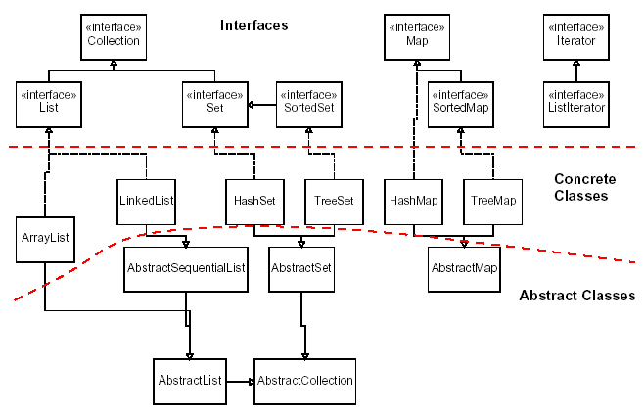
Java collections framework

Slide 3
Exercise
Write a program that counts the number of unique words in a large text file (say, Moby Dick or the King James Bible).
  Store the words in a collection and report the # of unique words.
  Once you've created this collection, allow the user to search it to see whether various words appear in the text file.
What collection is appropriate for this problem?

Slide 4
Empirical analysis
Running a program and measuring its performance
System.currentTimeMillis()
  Returns an integer representing the number of milliseconds that have passed since 12:00am, January 1, 1970.
    The result is returned as a value of type long, which is like int but with a larger numeric range (64 bits vs. 32).
  Can be called twice to see how many milliseconds have elapsed between two points in a program.
How much time does it take to store Moby Dick into a List?

Slide 5
Sets
set: A collection of unique values (no duplicates allowed)
that can perform the following operations efficiently:
  add, remove, search (contains)
  We don't think of a set as having indexes; we just
  add things to the set in general and don't worry about order
"the"
"of"
"if"
set.contains("to")
"to"
"down"
"from"
true
"by"
"she"
set.contains("be")
"you"
false
"in"
"why"
"him"
set

Slide 6
Set implementation
in Java, sets are represented by Set interface in java.util
Set is implemented by HashSet and TreeSet classes
  HashSet: implemented using a "hash table" array;
  very fast: O(1) for all operations
  elements are stored in unpredictable order
  TreeSet: implemented using a "binary search tree";
  pretty fast: O(log N) for all operations
  elements are stored in sorted order
  LinkedHashSet: O(1) but stores in order of insertion

Slide 7
Set methods
List<String> list = new ArrayList<String>();
...
Set<Integer> set = new TreeSet<Integer>(); // empty
Set<String> set2 = new HashSet<String>(list);
  can construct an empty set, or one based on a given collection
add(value) | adds the given value to the set
contains(value) | returns true if the given value is found in this set
remove(value) | removes the given value from the set
clear() | removes all elements of the set
size() | returns the number of elements in list
isEmpty() | returns true if the set's size is 0
toString() | returns a string such as "[3, 42, -7, 15]"

Slide 8
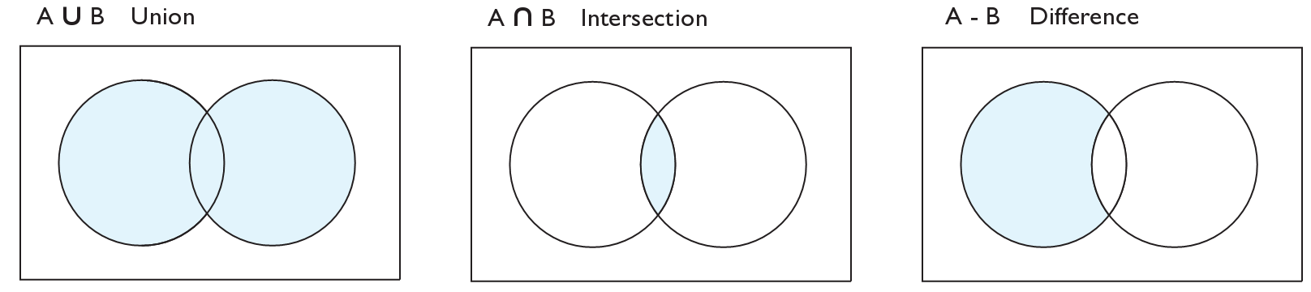
Set operations
addAll
retainAll
removeAll
addAll(collection) | adds all elements from the given collection to this set
containsAll(coll) | returns true if this set contains every element from given set
equals(set) | returns true if given other set contains the same elements
iterator() | returns an object used to examine set's contents (seen later)
removeAll(coll) | removes all elements in the given collection from this set
retainAll(coll) | removes elements not found in given collection from this set
toArray() | returns an array of the elements in this set

Slide 9
Sets and ordering
HashSet : elements are stored in an unpredictable order
  Set<String> names = new HashSet<String>();
  names.add("Jake");
  names.add("Robert");
  names.add("Marisa");
  names.add("Kasey");
  System.out.println(names);
  // [Kasey, Robert, Jake, Marisa]
TreeSet : elements are stored in their "natural" sorted order
  Set<String> names = new TreeSet<String>();
  ...
  // [Jake, Kasey, Marisa, Robert]
LinkedHashSet : elements stored in order of insertion
  Set<String> names = new LinkedHashSet<String>();
  ...
  // [Jake, Robert, Marisa, Kasey]

Slide 10
The "for each" loop
for (type name : collection) {
statements;
}
Provides a clean syntax for looping over the elements of a Set, List, array, or other collection
  Set<Double> grades = new HashSet<Double>();
  ...
  for (double grade : grades) {
  System.out.println("Student's grade: " + grade);
  }
  needed because sets have no indexes; can't get element i

Slide 11
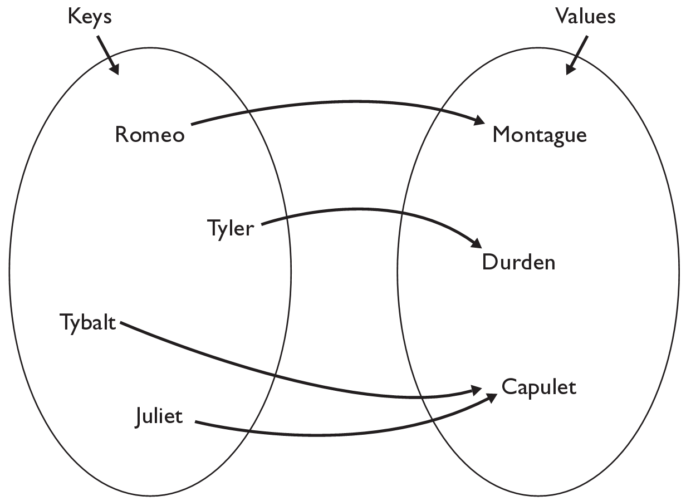
Map
map: Holds a set of unique keys and a collection of values, where each key is associated with one value.
  a.k.a. "dictionary", "associative array", "hash"
basic map operations:
  put(key, value ): Adds a
  mapping from a key to
  a value.
  get(key ): Retrieves the
  value mapped to the key.
  remove(key ): Removes
  the given key and its
  mapped value.
myMap.get("Juliet") returns "Capulet"

Slide 12
Maps and tallying
a map can be thought of as generalization of a tallying array
  the "index" (key) doesn't have to be an int
recall previous tallying examples from CSE 142
  count digits: 22092310907
  count votes: "MOOOOOOMMMMMOOOOOOMOMMIMOMMIMOMMIO"
index | 0 | 1 | 2 | 3 | 4 | 5 | 6 | 7 | 8 | 9
value | 3 | 1 | 3 | 0 | 0 | 0 | 0 | 1 | 0 | 2
key | "M" | "O" | "I"
value | 16 | 14 | 3
"M"
14
"O"
3
"I"
16
keys
values

Slide 13
Map implementation
in Java, maps are represented by Map interface in java.util
Map is implemented by the HashMap and TreeMap classes
  HashMap: implemented using an array called a "hash table";
  extremely fast: O(1) ; keys are stored in unpredictable order
  TreeMap: implemented as a linked "binary tree" structure;
  very fast: O(log N) ; keys are stored in sorted order
  A map requires 2 type parameters: one for keys, one for values.
// maps from String keys to Integer values
Map<String, Integer> votes = new HashMap<String, Integer>();

Slide 14
Map methods
put(key, value) | adds a mapping from the given key to the given value; if the key already exists, replaces its value with the given one
get(key) | returns the value mapped to the given key (null if not found)
containsKey(key) | returns true if the map contains a mapping for the given key
remove(key) | removes any existing mapping for the given key
clear() | removes all key/value pairs from the map
size() | returns the number of key/value pairs in the map
isEmpty() | returns true if the map's size is 0
toString() | returns a string such as "{a=90, d=60, c=70}"
keySet() | returns a set of all keys in the map
values() | returns a collection of all values in the map
putAll(map) | adds all key/value pairs from the given map to this map
equals(map) | returns true if given map has the same mappings as this one

Slide 15
Using maps
A map allows you to get from one half of a pair to the other.
  Remembers one piece of information about every index (key).
  Later, we can supply only the key and get back the related value:
    Allows us to ask: What is Marty's phone number?
// key value
put("Marty", "206-685-2181")
Map
get("Marty")
Map
"206-685-2181"

Slide 16
keySet and values
keySet method returns a set of all keys in the map
  can loop over the keys in a foreach loop
  can get each key's associated value by calling get on the map
  Map<String, Integer> ages = new HashMap<String, Integer>();
  ages.put("Marty", 19);
  ages.put("Geneva", 2);
  ages.put("Vicki", 57);
  for (String name : ages.keySet()) { // Geneva -> 2
  int age = ages.get(age); // Marty -> 19
  System.out.println(name + " -> " + age); // Vicki -> 57
  }
values method returns a collection of all values in the map
  can loop over the values in a foreach loop
  there is no easy way to get from a value to its associated key(s)

Slide 17
Maps vs. sets
A set is like a map from elements to boolean values.
  Set: Is "Marty" found in the set? (true/false)
  Map: What is "Marty" 's phone number?
"Marty"
Set
true
false
"Marty"
Map
"206-685-2181"

Slide 18
keySet and values
keySet method returns a Set of all keys in the map
  can loop over the keys in a foreach loop
  can get each key's associated value by calling get on the map
  Map<String, Integer> ages = new TreeMap<String, Integer>();
  ages.put("Marty", 19);
  ages.put("Geneva", 2); // ages.keySet() returns Set<String>
  ages.put("Vicki", 57);
  for (String name : ages.keySet()) { // Geneva -> 2
  int age = ages.get(name); // Marty -> 19
  System.out.println(name + " -> " + age); // Vicki -> 57
  }
values method returns a collection of all values in the map
  can loop over the values in a foreach loop
  no easy way to get from a value to its associated key(s)

Slide 19
Problem: opposite mapping
It is legal to have a map of sets, a list of lists, etc.
Suppose we want to keep track of each TA's GPA by name.
  Map<String, Double> taGpa = new HashMap<String, Double>();
  taGpa.put("Jared", 3.6);
  taGpa.put("Alyssa", 4.0);
  taGpa.put("Steve", 2.9);
  taGpa.put("Stef", 3.6);
  taGpa.put("Rob", 2.9);
  ...
  System.out.println("Jared's GPA is " +
  taGpa.get("Jared")); // 3.6
This doesn't let us easily ask which TAs got a given GPA.
  How would we structure a map for that?

Slide 20
Reversing a map
We can reverse the mapping to be from GPAs to names.
  Map<Double, String> taGpa = new HashMap<Double, String>();
  taGpa.put(3.6, "Jared");
  taGpa.put(4.0, "Alyssa");
  taGpa.put(2.9, "Steve");
  taGpa.put(3.6, "Stef");
  taGpa.put(2.9, "Rob");
  ...
  System.out.println("Who got a 3.6? " +
  taGpa.get(3.6)); // ???
What's wrong with this solution?
  More than one TA can have the same GPA.
  The map will store only the last mapping we add.

Slide 21
Proper map reversal
Really each GPA maps to a collection of people.
  Map<Double, Set<String>> taGpa =
  new HashMap<Double, Set<String>>();
  taGpa.put(3.6, new TreeSet<String>());
  taGpa.get(3.6).add("Jared");
  taGpa.put(4.0, new TreeSet<String>());
  taGpa.get(4.0).add("Alyssa");
  taGpa.put(2.9, new TreeSet<String>());
  taGpa.get(2.9).add("Steve");
  taGpa.get(3.6).add("Stef");
  taGpa.get(2.9).add("Rob");
  ...
  System.out.println("Who got a 3.6? " +
  taGpa.get(3.6)); // [Jared, Stef]
  must be careful to initialize the set for a given GPA before adding

Slide 22
Exercises
Modify the word count program to print every word that appeared in the book at least 1000 times, in sorted order from least to most occurrences.
Write a program that reads a list of TA names and quarters' experience, then prints the quarters in increasing order of how many TAs have that much experience, along with their names.
  Allison 5 1 qtr: [Brian]
  Alyssa 8 2 qtr: ...
  Brian 1 5 qtr: [Allison, Kasey]
  Kasey 5
  ...

Slide 23
Iterators

Slide 24
Examining sets and maps
elements of Java Sets and Maps can't be accessed by index
  must use a "foreach" loop:
  Set<Integer> scores = new HashSet<Integer>();
  for (int score : scores) {
  System.out.println("The score is " + score);
  }
  Problem: foreach is read-only; cannot modify set while looping
  for (int score : scores) {
  if (score < 60) {
  // throws a ConcurrentModificationException
  scores.remove(score);
  }
  }

Slide 25
Iterators
iterator: An object that allows a client to traverse the elements of any collection.
  Remembers a position, and lets you:
    get the element at that position
    advance to the next position
    remove the element at that position
index | 0 | 1 | 2 | 3 | 4 | 5 | 6 | 7 | 8 | 9
value | 3 | 8 | 9 | 7 | 5 | 12 | 0 | 0 | 0 | 0
size | 6
"the"
list
set
"to"
"we"
"from"
current element: 9
current index: 2
current element: "from"
next element: "the"
iterator
iterator

Slide 26
Iterator methods
hasNext() | returns true if there are more elements to examine
next() | returns the next element from the collection (throws a NoSuchElementException if there are none left to examine)
remove() | removes the last value returned by next() (throws an IllegalStateException if you haven't called next() yet)
Iterator interface in java.util
  every collection has an iterator() method that returns an iterator over its elements
  Set<String> set = new HashSet<String>();
  ...
  Iterator<String> itr = set.iterator();
  ...

Slide 27
Iterator example
Set<Integer> scores = new TreeSet<Integer>();
scores.add(94);
scores.add(38); // Kim
scores.add(87);
scores.add(43); // Marty
scores.add(72);
...
Iterator<Integer> itr = scores.iterator();
while (itr.hasNext()) {
int score = itr.next();
System.out.println("The score is " + score);
// eliminate any failing grades
if (score < 60) {
itr.remove();
}
}
System.out.println(scores); // [72, 87, 94]

Slide 28
Iterator example 2
Map<String, Integer> scores = new TreeMap<String, Integer>();
scores.put("Kim", 38);
scores.put("Lisa", 94);
scores.put("Roy", 87);
scores.put("Marty", 43);
scores.put("Marisa", 72);
...
Iterator<String> itr = scores.keySet().iterator();
while (itr.hasNext()) {
String name = itr.next();
int score = scores.get(name);
System.out.println(name + " got " + score);
// eliminate any failing students
if (score < 60) {
itr.remove(); // removes name and score
}
}
System.out.println(scores); // {Lisa=94, Marisa=72, Roy=87}

Slide 29
Exercise
Write a program to count the occurrences of each word in a large text file (e.g. Moby Dick or the King James Bible).
  Allow the user to type a word and report how many times that word appeared in the book.
  Report all words that appeared in the book at least 500 times, in alphabetical order.
How will we store the data to solve this problem?

Slide 30
Exercise solution
// read file into a map of [word --> number of occurrences]
Map<String, Integer> wordCount = new HashMap<String, Integer>();
Scanner input = new Scanner(new File("mobydick.txt"));
while (input.hasNext()) {
String word = input.next();
if (wordCount.containsKey(word)) {
// seen this word before; increase count by 1
int count = wordCount.get(word);
wordCount.put(word, count + 1);
} else {
// never seen this word before
wordCount.put(word, 1);
}
}
Scanner console = new Scanner(System.in);
System.out.print("Word to search for? ");
String word = console.next();
System.out.println("appears " + wordCount.get(word) + " times.");

Slide 31
Languages and Grammars

Slide 32
Languages and grammars
(formal) language: A set of words or symbols.
grammar: A description of a language that describes which sequences of symbols are allowed in that language.
  describes language syntax (rules) but not semantics (meaning)
  can be used to generate strings from a language, or to determine whether a given string belongs to a given language

Slide 33
Backus-Naur (BNF)
Backus-Naur Form (BNF): A syntax for describing language grammars in terms of transformation rules, of the form:
  <symbol> ::= <expression> | <expression> ... | <expression>
  terminal: A fundamental symbol of the language.
  non-terminal: A high-level symbol describing language syntax, which can be transformed into other non-terminal or terminal symbol(s) based on the rules of the grammar.
  developed by two Turing-award-winning computer scientists in 1960 to describe their new ALGOL programming language

Slide 34
An example BNF grammar
  <s>::=<n> <v>
  <n>::=Marty | Victoria | Stuart | Jessica
  <v>::=cried | slept | belched
Some sentences that could be generated from this grammar:
  Marty slept
  Jessica belched
  Stuart cried

Slide 35
BNF grammar version 2
  <s>::=<np> <v>
  <np>::=<pn> | <dp> <n>
  <pn>::=Marty | Victoria | Stuart | Jessica
  <dp>::=a | the
  <n>::=ball | hamster | carrot | computer
  <v>::=cried | slept | belched
Some sentences that could be generated from this grammar:
  the carrot cried
  Jessica belched
  a computer slept

Slide 36
BNF grammar version 3
  <s>::=<np> <v>
  <np>::=<pn> | <dp> <adj> <n>
  <pn>::=Marty | Victoria | Stuart | Jessica
  <dp>::=a | the
  <adj>::=silly | invisible | loud | romantic
  <n>::=ball | hamster | carrot | computer
  <v>::=cried | slept | belched
Some sentences that could be generated from this grammar:
  the invisible carrot cried
  Jessica belched
  a computer slept
  a romantic ball belched

Slide 37
Grammars and recursion
  <s>::=<np> <v>
  <np>::=<pn> | <dp> <adjp> <n>
  <pn>::=Marty | Victoria | Stuart | Jessica
  <dp>::=a | the
  <adjp>::=<adj> <adjp> | <adj>
  <adj>::=silly | invisible | loud | romantic
  <n>::=ball | hamster | carrot | computer
  <v>::=cried | slept | belched
Grammar rules can be defined recursively, so that the expansion of a symbol can contain that same symbol.
  There must also be expressions that expand the symbol into something non-recursive, so that the recursion eventually ends.

Slide 38
Grammar, final version
  <s>::=<np> <vp>
  <np>::=<dp> <adjp> <n>|<pn>
  <dp>::=the|a
  <adjp>::=<adj>|<adj> <adjp>
  <adj>::=big|fat|green|wonderful|faulty|subliminal
  <n>::=dog|cat|man|university|father|mother|child
  <pn>::=John|Jane|Sally|Spot|Fred|Elmo
  <vp>::=<tv> <np>|<iv>
  <tv>::=hit|honored|kissed|helped
  <iv>::=died|collapsed|laughed|wept
Could this grammar generate the following sentences?
  Fred honored the green wonderful child
  big Jane wept the fat man fat
Generate a random sentence using this grammar.

Slide 39
Sentence generation
<s>
<np>
<vp>
<pn>
<tv>
<np>
<dp>
<adjp>
<n>
<adj>
<adjp>
<adj>
Fred
honored
the
green
wonderful
child

